Slide 1
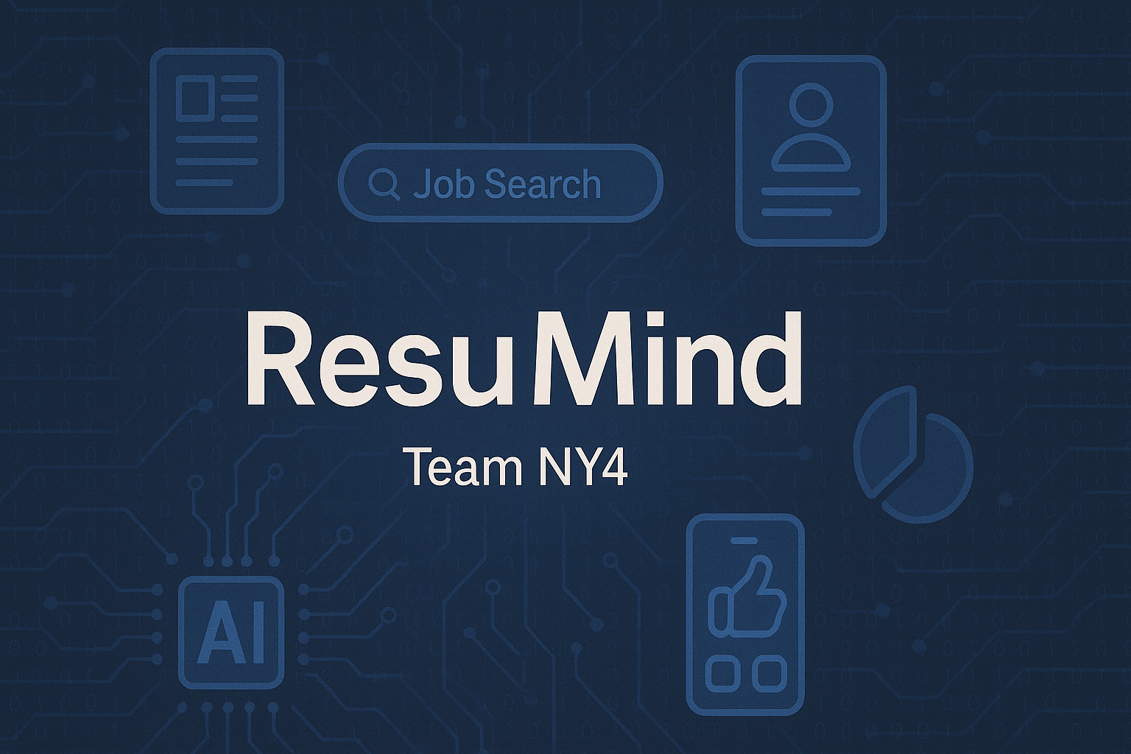

Slide 2




Team Introduction
Anika Bushra
Front End Developer
Eric Lantz
Front End Developer
Sarah Wierzbicki
Machine Learning Trainer/Developer
Joseph Indriolo
Backend/DevOps Engineer

Slide 3
Agenda
Problem Statement
Description
Personas
Technologies
Algorithms
Team Working Agreement
Completed Tasks
Retrospective

Slide 4
Problem Statement
Whether you are actively or passively searching for a job, looking for new opportunities can be overwhelming due to:
High volume of listings on job sites such as Indeed, LinkedIn, Monster
Lack of matching/relevant skills
Fake job postings
There is a clear need for a smarter, more personalized approach to job discovery—one that truly understands the applicant, while making the job selection process simple and clear.

Slide 5
Project Description
ResuMind is an AI-powered job assistant that personalizes the job search experience for job seekers who struggle to find roles that match their skills and career goals. Our application uses natural language processing to recommend verified job opportunities and helps users understand how closely they fit the role. Unlike traditional job boards that require manual filtering, ResuMind offers a tailored experience by highlighting key details, comparison of strong skills versus areas of improvement, and ways to enhance your resume.
Benefits include:
Reduced job search time
Skill match insights
Resume feedback
Interview prep

Slide 6
Personas

Slide 7
Maria Smith, Returning to Workforce Parent
Age: 40
Background: Former advertising professional that took an 8-year gap to raise children
Job search style: Moderately active
Skills: Microsoft suite, content creation, Adobe creative suite, client communication
Challenges: Unsure of how to present career gap, finding jobs that match previous skills acquired, how to market herself as a competitive candidate
Needs: Resume refresh guidance, remote/hybrid work environment, personalized job recommendations based on experience

Slide 8
John Lang, Laid-Off Senior Director
Age: 51
Background: Senior Software Engineer Director with 20+ years of relevant experience, recently got laid off due to company budget cuts.
Job search style: Actively searching
Skills: Agile/scrum leadership, cloud platforms, people leader, system design
Challenges: Difficulty navigating a saturated environment, overqualified for many roles
Needs: Competitive salary, curated job listings, specialized skill match

Slide 9
Lisa Burns, Entry-Mid Level Analyst
Age: 28
Background: 4 years as a data analyst in the healthcare industry, looking to transition to the finance industry
Job search style: Passively seeking
Skills: SQL, Python, Data cleaning/validation, advanced proficiency in Excel
Challenges: Lack of time to seek new opportunities, irrelevant job alerts, limited knowledge of financial industry
Needs: High quality job suggestions, analysis of skill transferability, access to learning resources

Slide 10
Project Schedule
Sprint 0
Decide project topic and problem statement
Sprint 1
June 11th – July 9th
Sprint 2
July 9th – August 22nd
May 22nd – June 11th
Finalize technologies and team member roles
Create wiki page and personas
Research and define technical architecture
Create diagrams
Work on MVP, create user stories
Establish base components (key features and machine learning model
Analyze performance metrics
Finalize technical paper
Complete project demo
Complete deployment and installation manual
m
Weekly meetings will be held at Wednesdays at 8:30 PM to review our progress together and establish weekly individual tasks

Slide 11



Technologies
Languages, libraries and frameworks:
Database Management
Tools
Front-end:
React, JavaScript,Node.js,Express,js
Back-end:
Python, PyTorch, Flask
Libraries:
SpaCy, Scikit-Learn, HuggingFace
MongoDB, AWS
Google Colab
WhatsApp
Microsoft Teams
GitHub
Jira
VSCode
Amazon EC2

Slide 12
Algorithms & Design
Natural Language Processing
Using the open-source library SpaCy, performing named entity recognition (NER) for keyword extraction
Resumes will be parsed using this process to extract valuable text.
Text - Classification Model
Our fine-tuned model, which uses RoBERTa as the base model, was trained on 2500 resumes with the goal of text classification.
This model will then make a prediction on the extracted text and create a user category based on their skills and experience

Slide 13
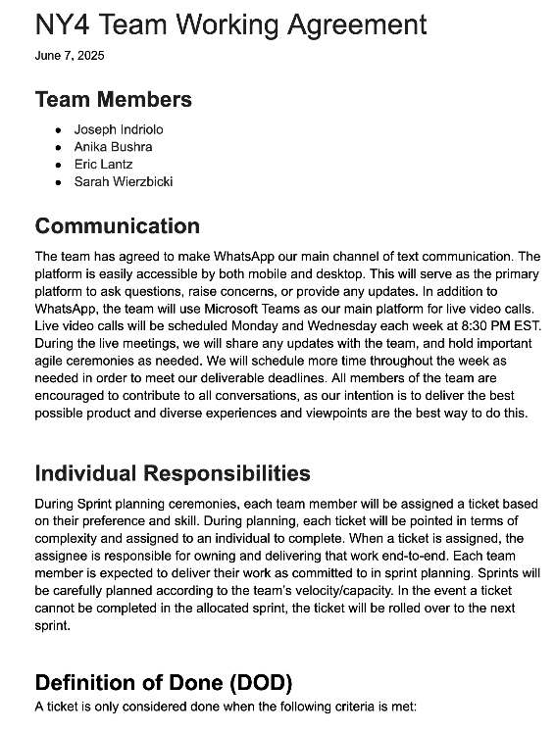
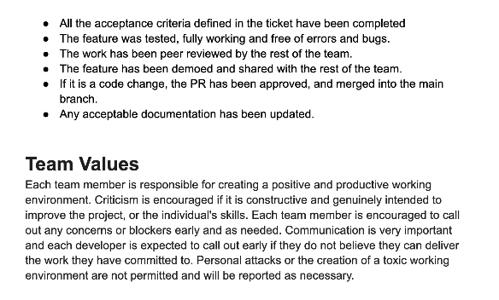
Team Working Agreement
m
Team Working Agreement

Slide 14
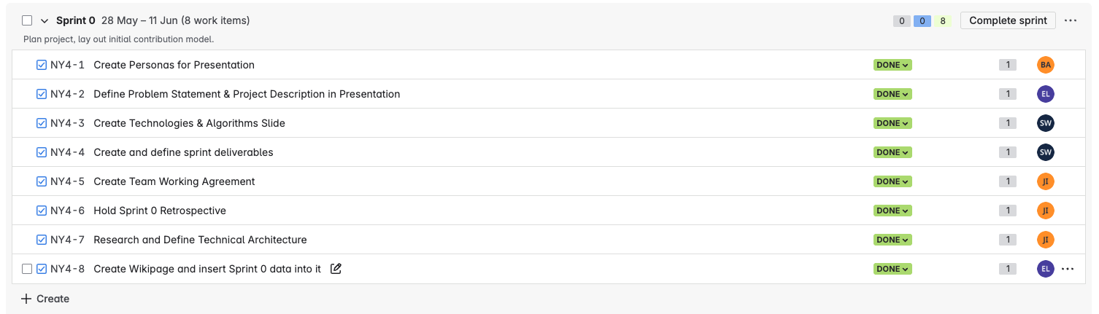
Completed Tasks – Sprint 0
m

Slide 15
Sprint 1 Agenda
Improvements
MVP
Diagrams (Architecture Diagrams, Context Diagram, ER Diagrams, Sequence Diagram, State Diagrams, Class Diagrams)
Product Backlog
User Stories & Acceptance Criteria
Metrics (Team velocity, burndown chart, completed/committed ratio)
Prototype Video
Website Screenshots
Test cases
Sprint 1 Retrospective
Sprint 2 Backlog

Slide 16
Improvements
Ensure clear audio across all recordings
Elaborate on each retrospective within the PowerPoint presentation
Clearly define and communicate MVP

Slide 17
MVP
Our vision: Helping job seekers efficiently find relevant opportunities by scanning their resumes for keywords and experience, then offering a simple swipe-based system to explore those matches.
Core Functionality:
Resume Upload: Users upload their resume directly onto the platform.
Keyword-Based Resume Parsing: Natural language processing extracts information from resumes and our machine learning model determines a relevant job category based on the resume.
Job Search & Swipe Interface: Based on content from the parsed resume, a curated list of relevant jobs is generated. Users can swipe right to like or left to dismiss – like a dating app, but for job hunting instead.
Matched Jobs List: Liked jobs are saved to a Matched Jobs page where users can review a match percentage and the application.
m

Slide 18
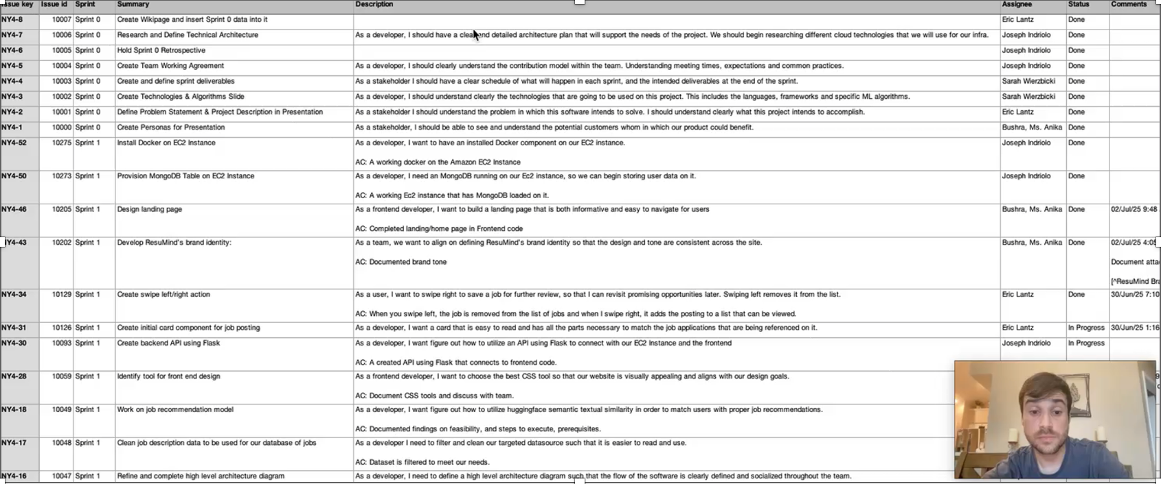
Product Backlog
m

Slide 19
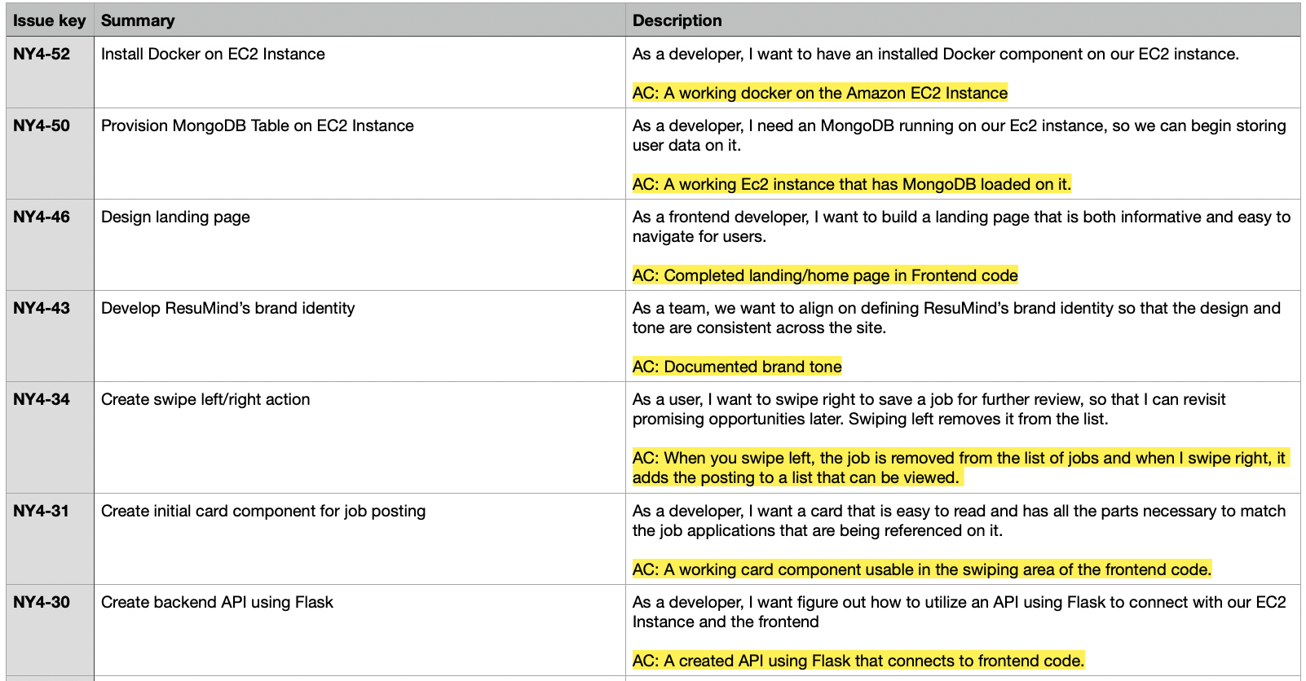
User Stories and Acceptance Criteria
m

Slide 20
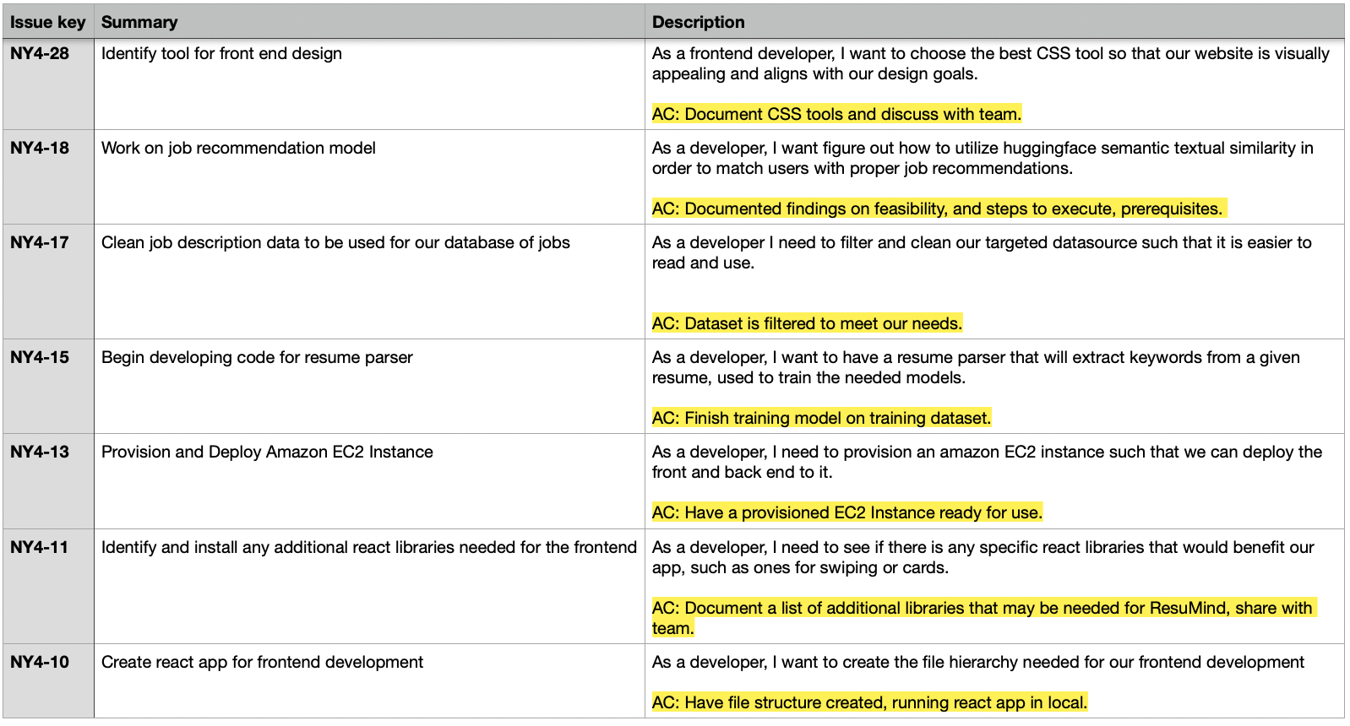
User Stories and Acceptance Criteria Cont.
m

Slide 21
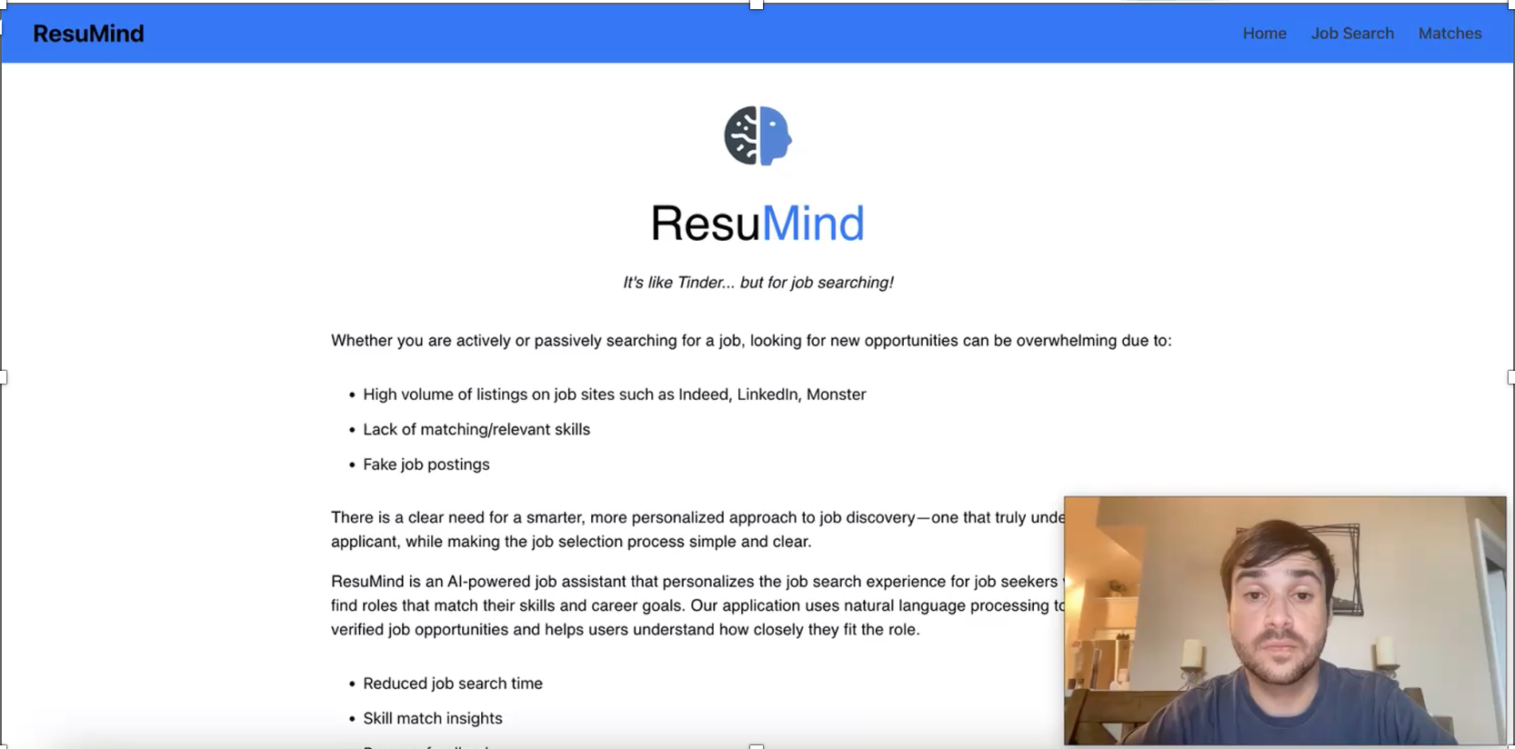
Prototype Video
m

Slide 22
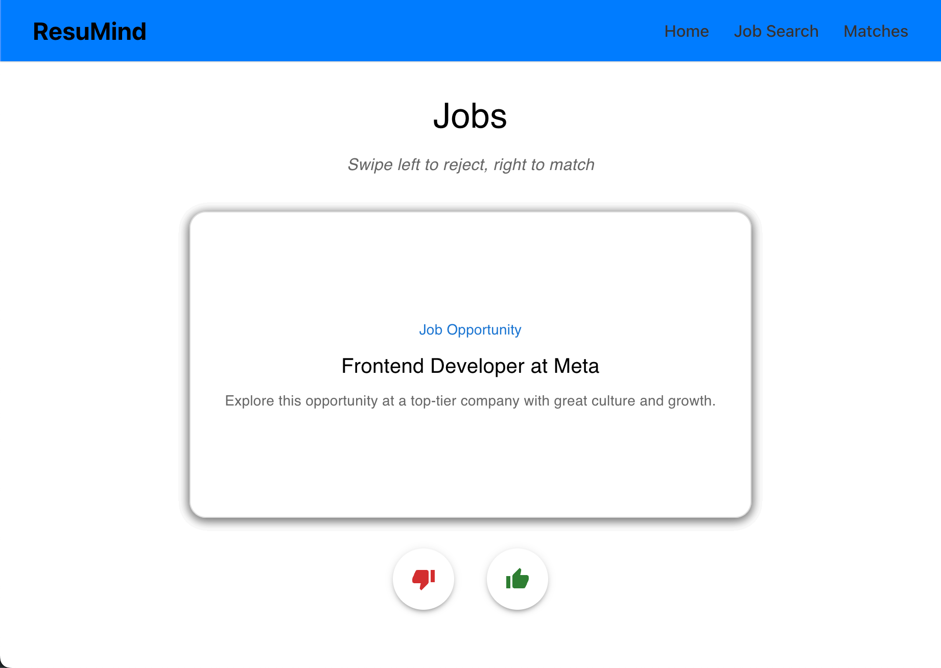
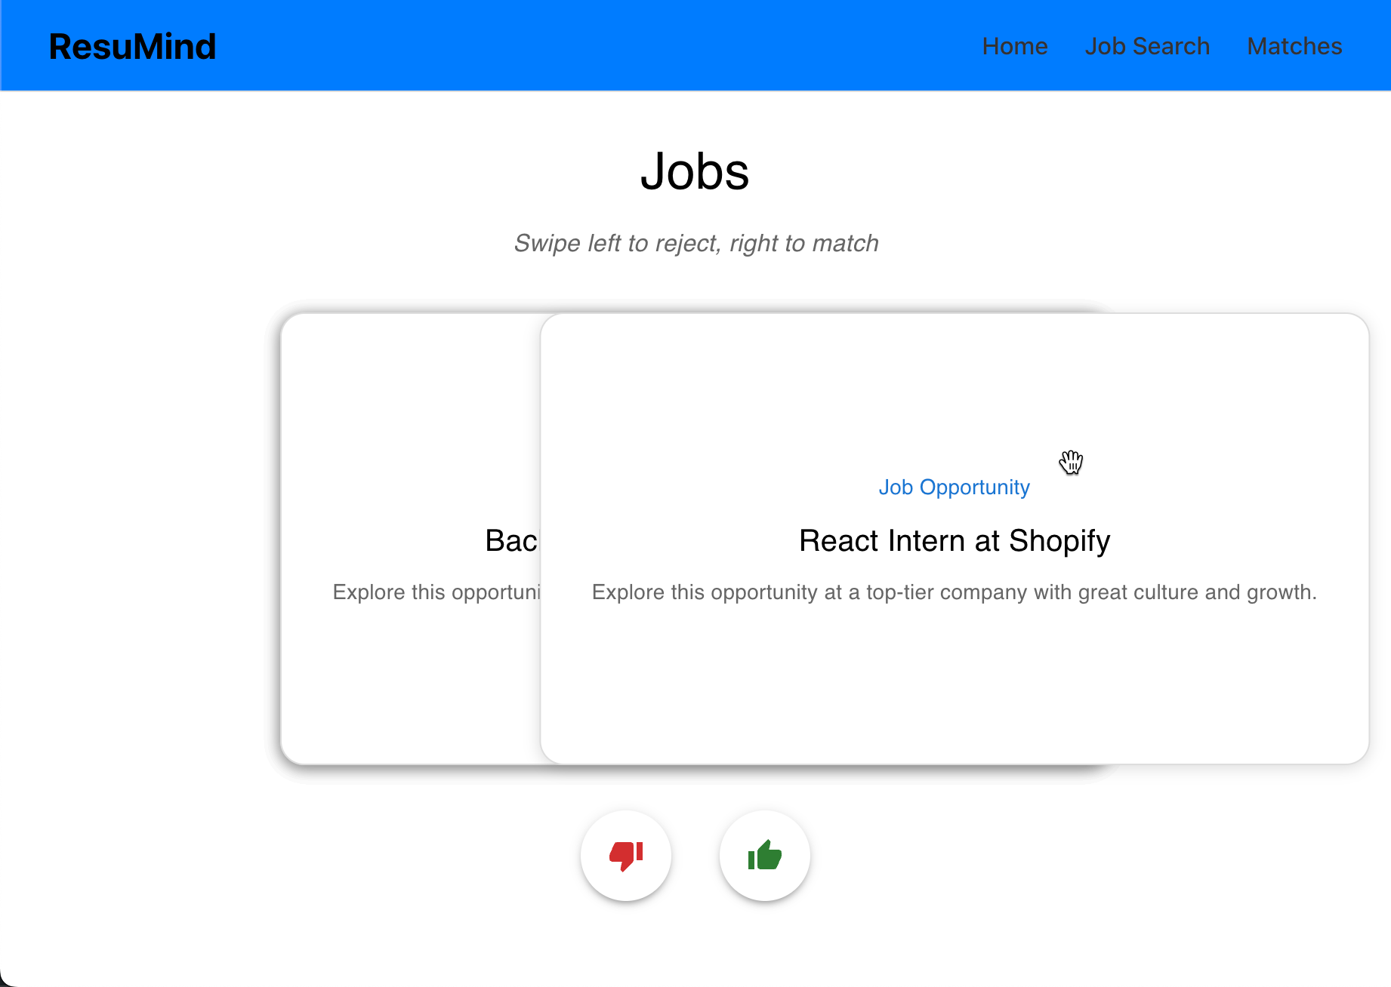
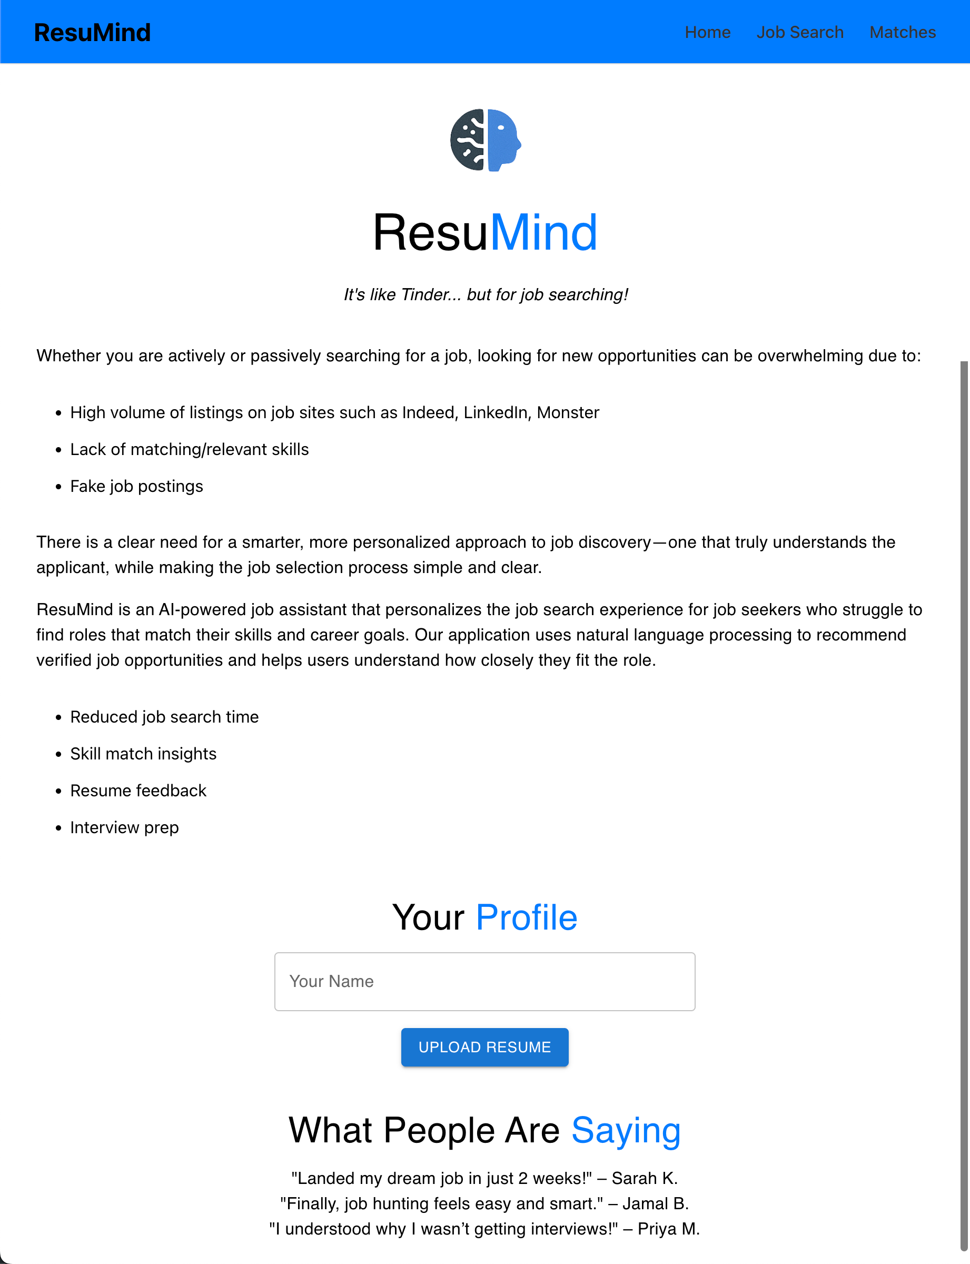
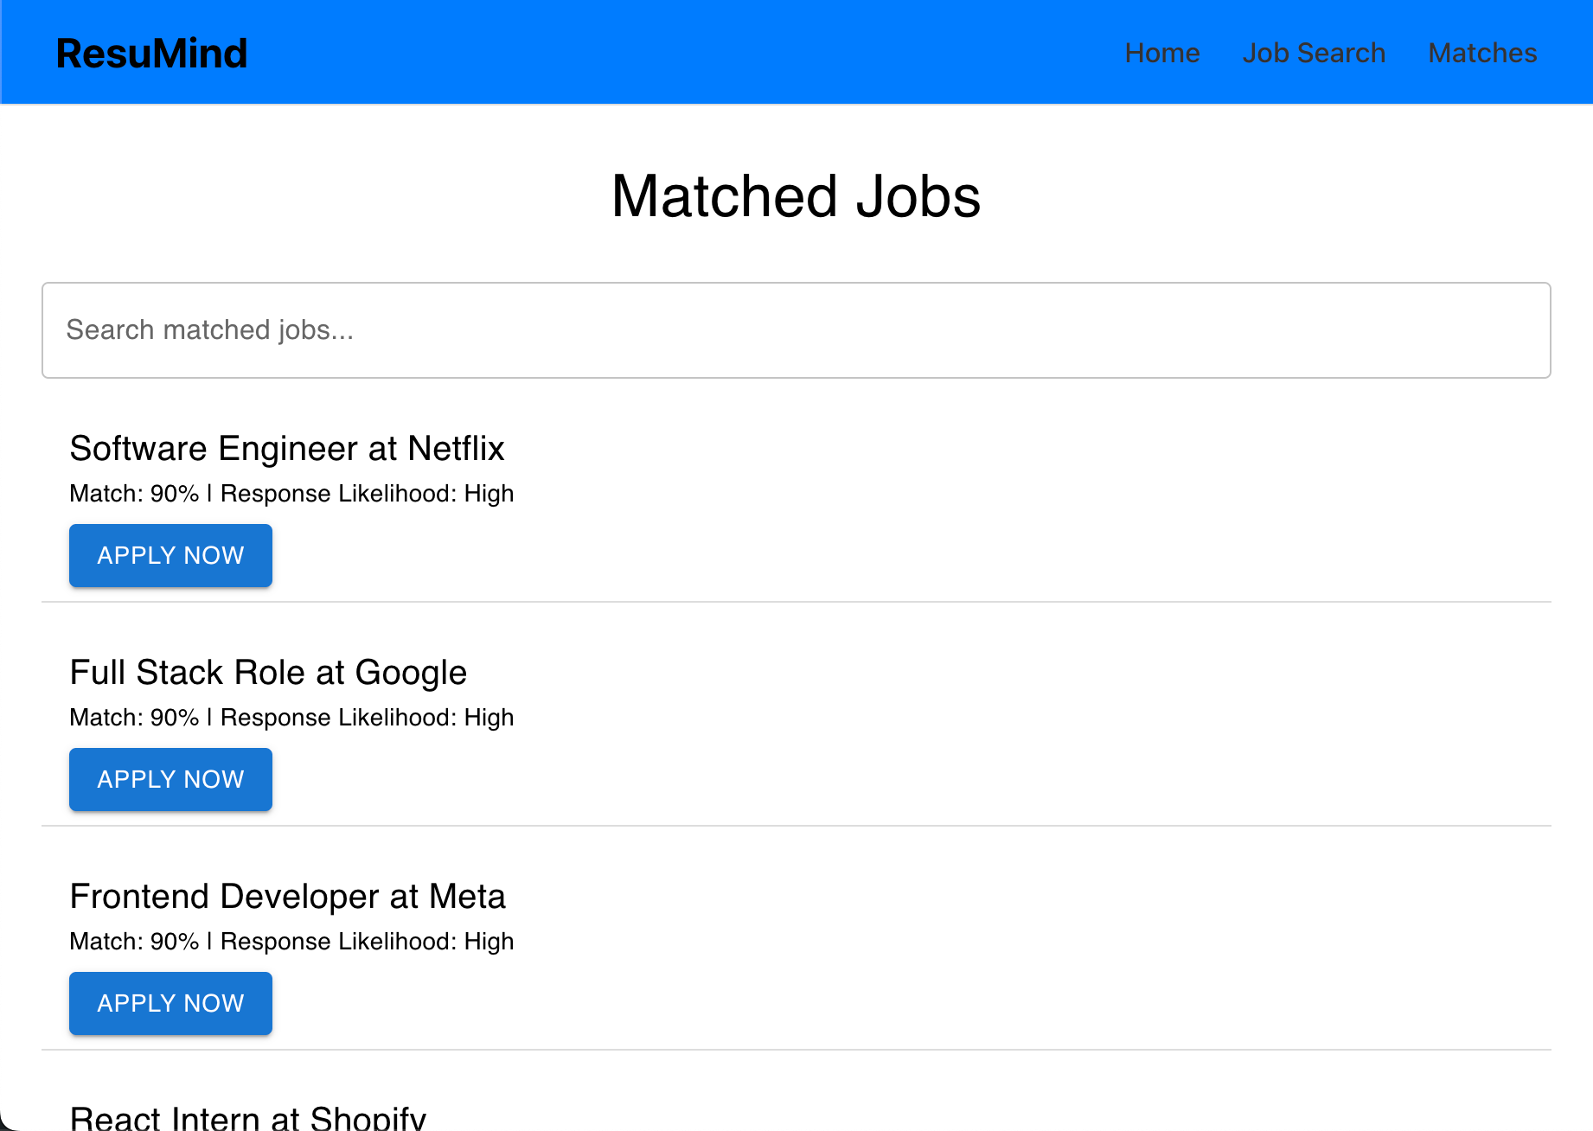
Website Screenshots
m

Slide 23
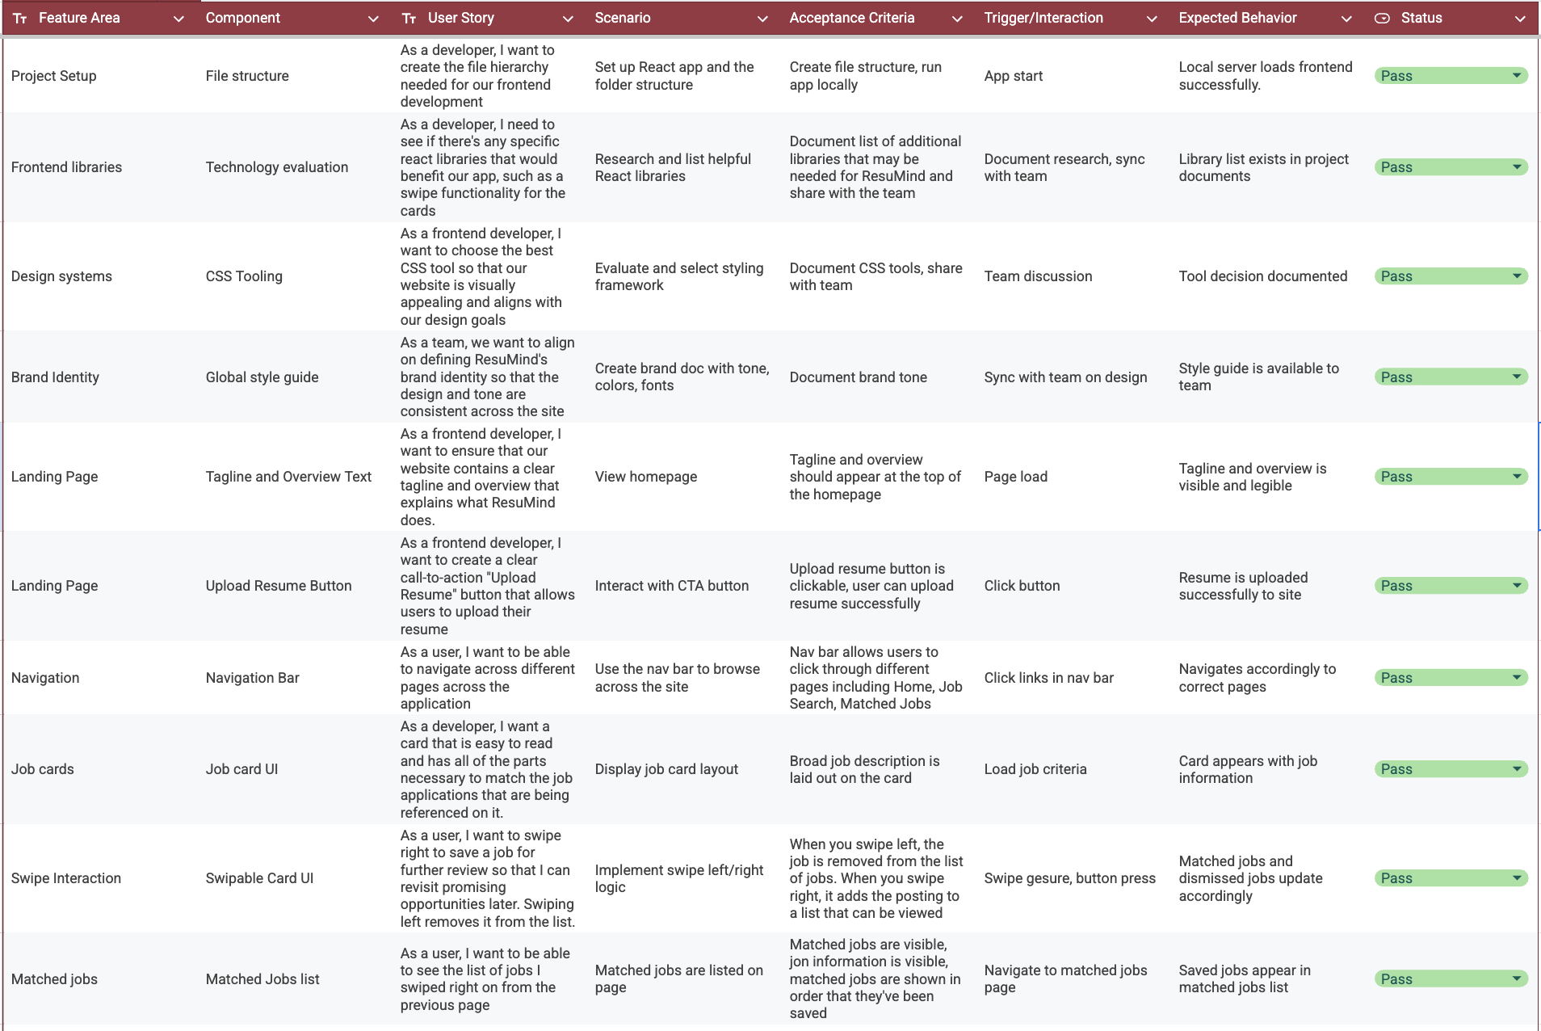
Test Cases
m

Slide 24

Metrics
Key Items:
Team Velocity
Burnout chart
Completed/Committed Ratio

Slide 25

Team Velocity
Initial committed story points : 19 points
Final committed story points: 25 points
One task unresolved during Sprint 1
25 points is our team velocity
We exceeded our initial commitment
Only one task on the backend was moved to our backlog for the next sprint.

Slide 26
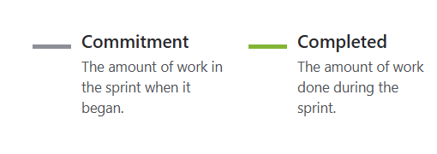
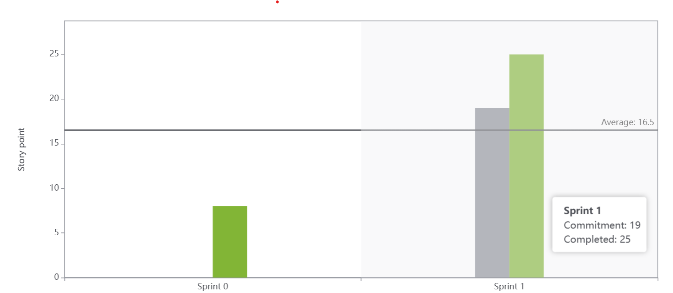
Committed/Completed Ratio
25/19 = 1.32

Slide 27
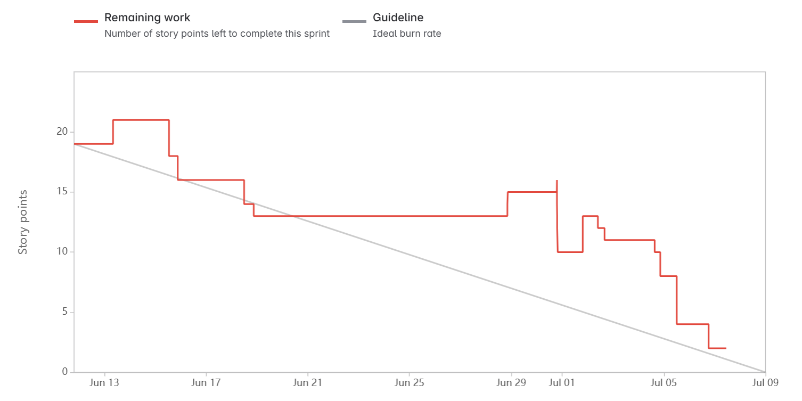
Burnout Chart

Slide 28
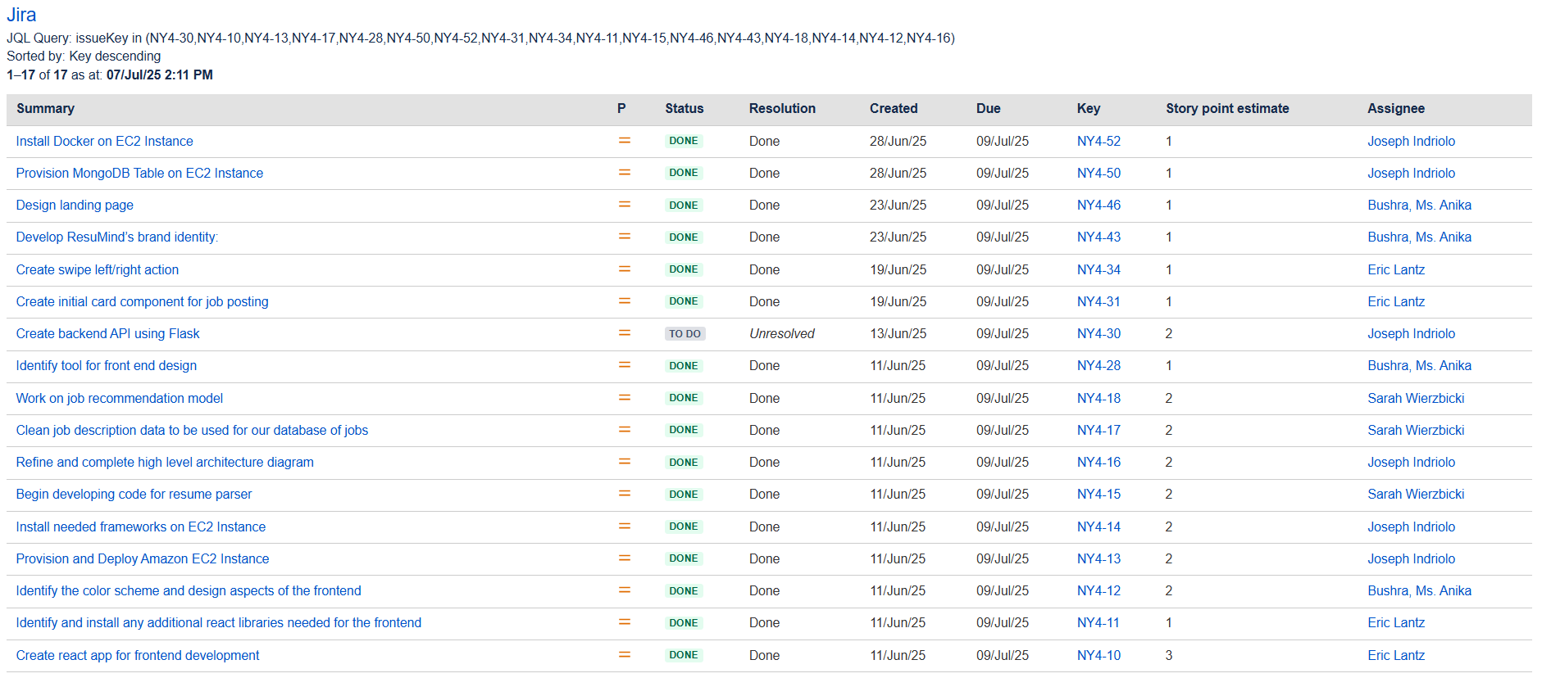
Metrics Summary/Completed Tasks

Slide 29
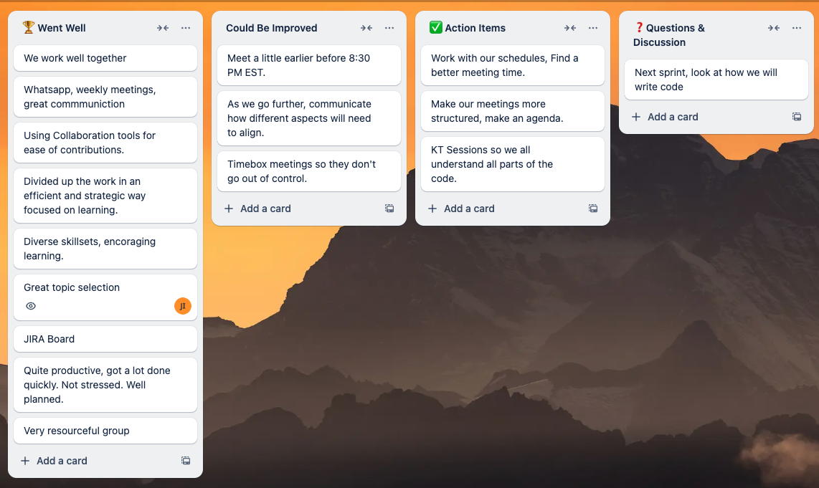
Sprint 0 Retrospective
m
Sprint Retrospective Board

Slide 30
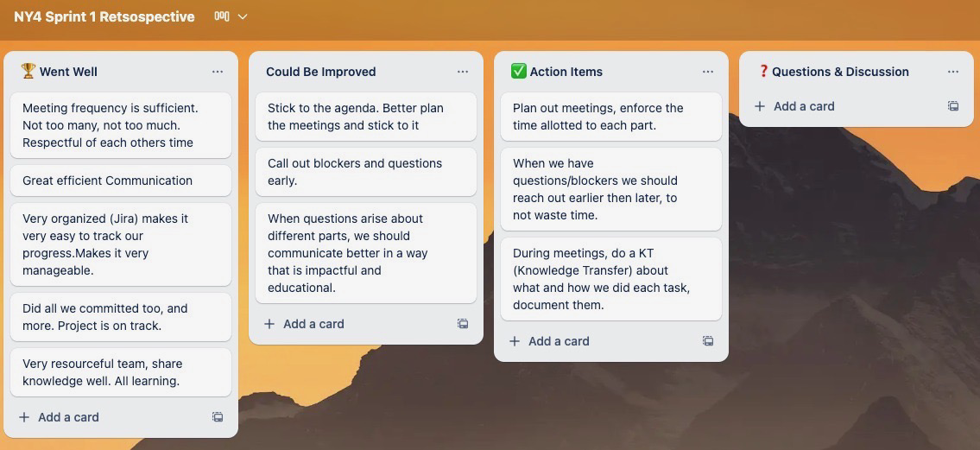
Sprint 1 Retrospective
m
Sprint Retrospective Board

Slide 31
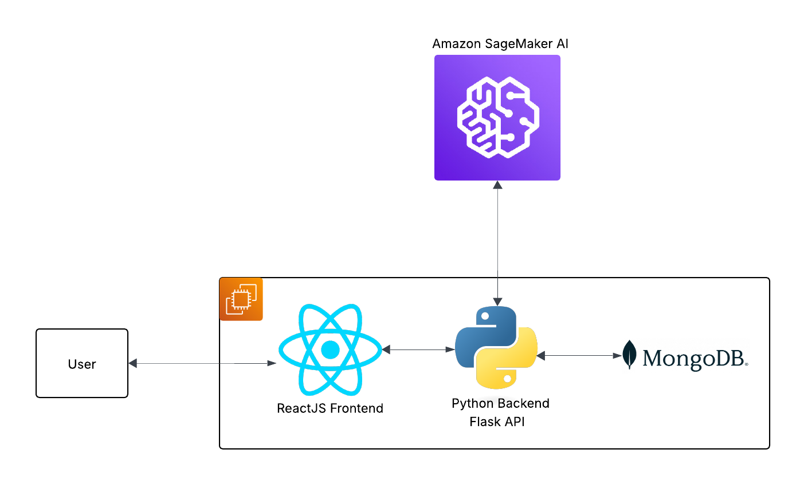
Architecture Diagram
m

Slide 32
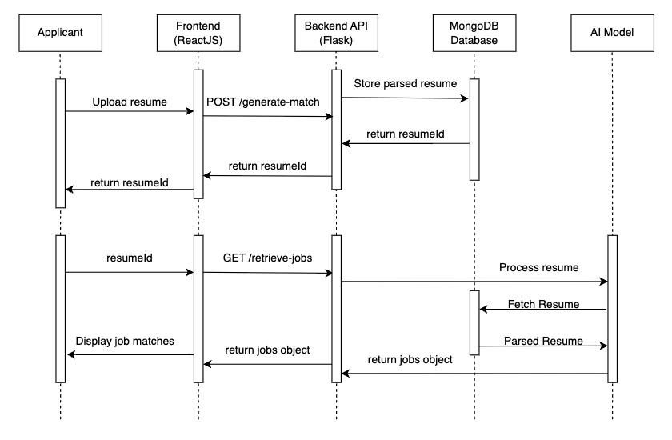
Sequence Diagram
m

Slide 33
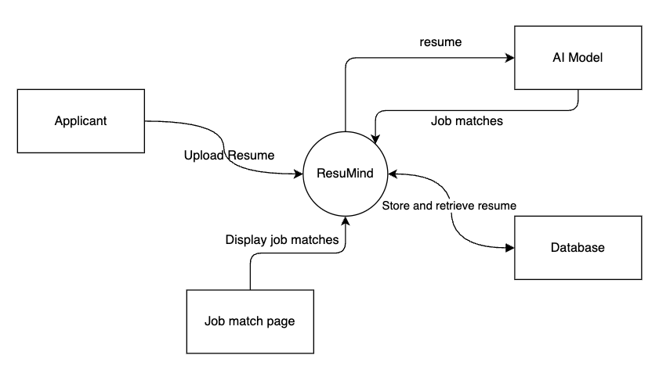
Context Diagram
m

Slide 34
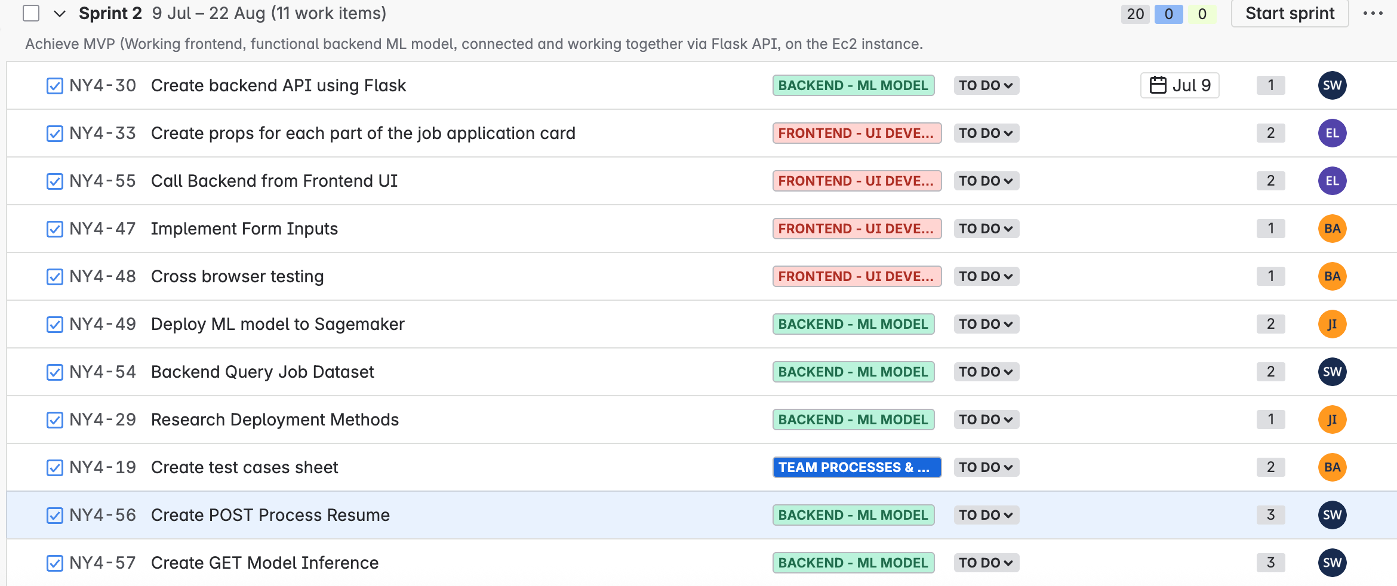
Sprint 2 Planned Stories
m

Slide 35
Wiki Link: https://github.com/htmw/2025Su-NY4/wiki

